Slide 1
Review:
What is a prime number?
A number that can only be divided by 1 and itself!
What is a factor?
A number that when multiplied with another results in an expected number.
What about a Prime Factor?

Slide 2
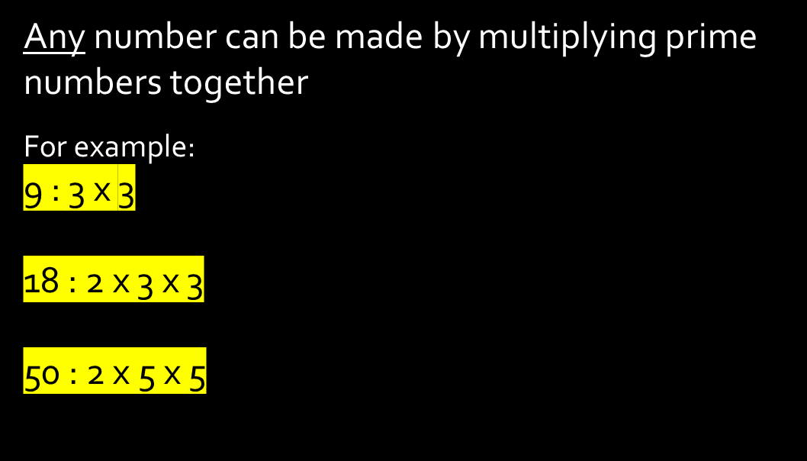
24
7
30
Prime Factors
Date
EQ – What are prime factors?
What is a prime factor?
What is a prime factor tree?
A prime factor tree is a way to organize factors of a number and to continue until all are prime numbers
9

Slide 3
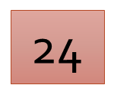
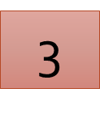
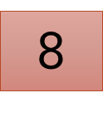
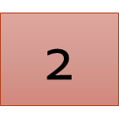
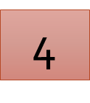
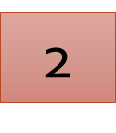

Find the Prime Factors of 24
To find the Prime Factors draw a factor tree
Split 24 into a pair of factors
Split 8 into a pair of factors
PRIME
Split 4 into a pair of factors
PRIME
THE PRIME FACTORS OF 24 ARE :
2 X 2 X 2 X 3
PRIME
PRIME

Slide 4
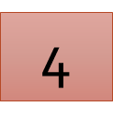
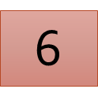
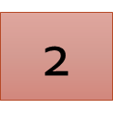


Find the Prime Factors of 24
To find the Prime Factors draw a factor tree
Split 24 into a pair of factors
Split 6 into a pair of factors
Split 4 into a pair of factors
PRIME
PRIME
PRIME
PRIME
THE PRIME FACTORS OF 24 ARE :
2 X 2 X 2 X 3

Slide 5

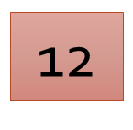
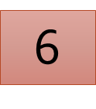
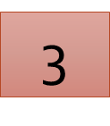
Find the Prime Factors of 24
To find the Prime Factors draw a factor tree
Split 24 into a pair of factors
Split 12 into a pair of factors
PRIME
Split 6 into a pair of factors
PRIME
THE PRIME FACTORS OF 24 ARE :
2 X 2 X 2 X 3
PRIME
PRIME

Slide 6
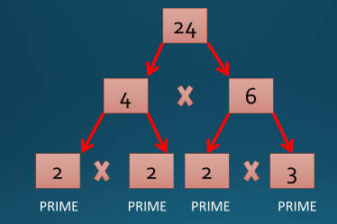
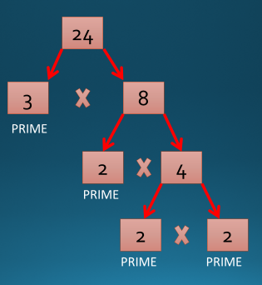
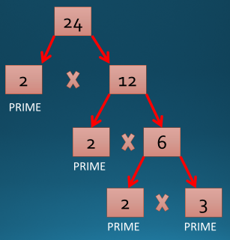
3 different ways
(starting with 3 different factor pairs)
All ending with the same prime factor pairs!!
2 X 2 X 2 X 3

Slide 7

12

